Slide 1
Accessibility evaluation (WCAG) https://vaccination-info.eu/en

Slide 2
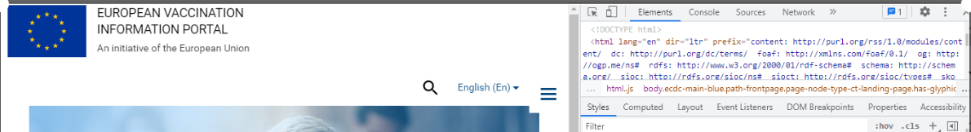
Lenguage of the web: is present, this allows screen readers to read the content appropriately. (Success Criterion 3.1.1)

Slide 3
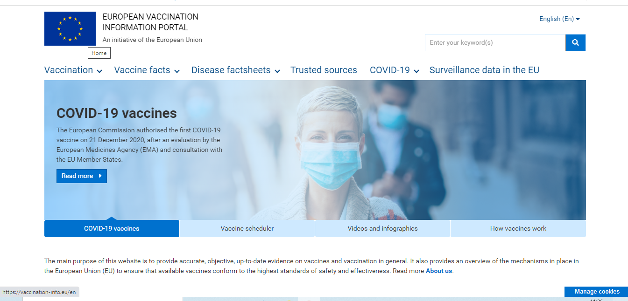
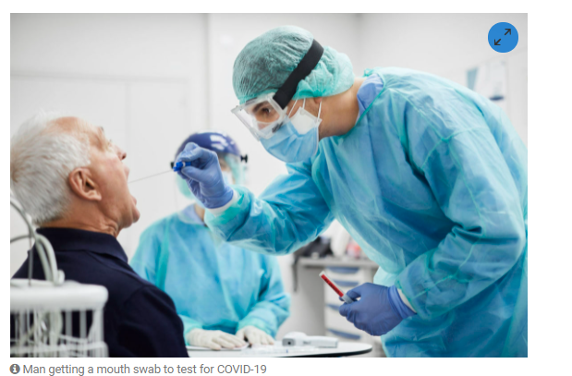
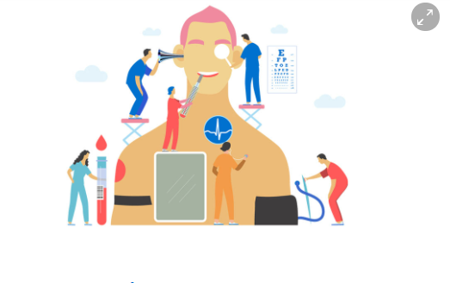
Alternative text
Alt text is present, the function and purpose of the link and the content of the image availabele for screen readers
(Success Criterion 1.1.1)
Alt text present in all the images of the web.

Slide 4
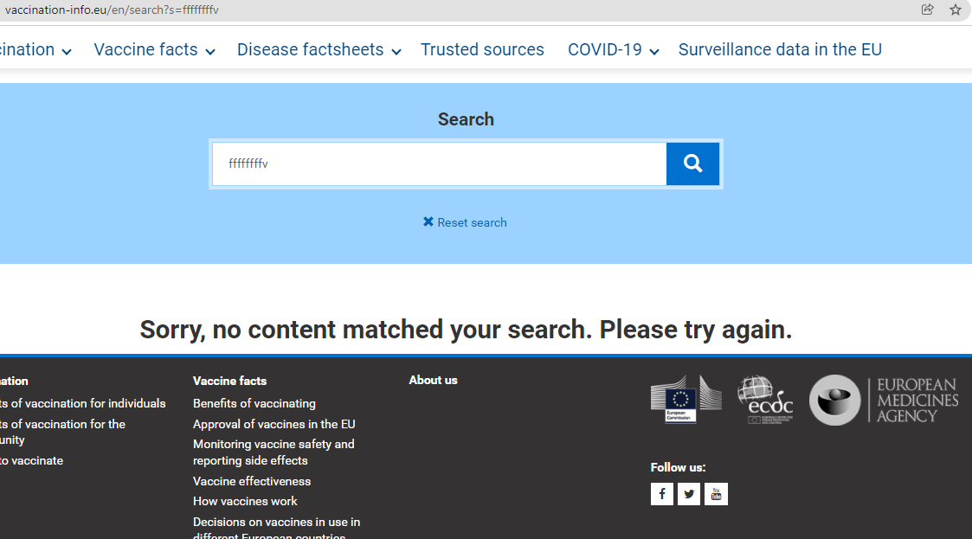
Error handling in the search engine provides a poor guidance for people to fix the problem.

Slide 5
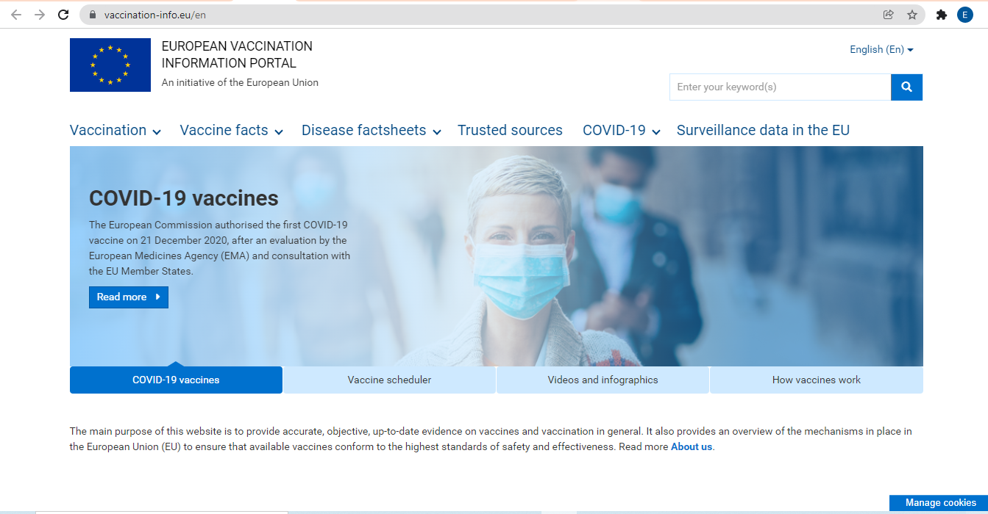
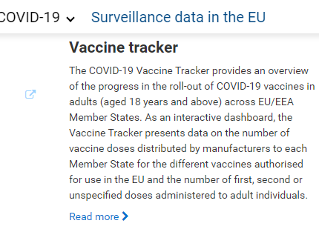
Links: When link goes to same Url, this results in additional navigation and repetition for keyboard and screen reader users.
Link goes to same URL (Success Criterion 2.4.4)
Link uses general text which doesn`t explain link purpose.
(Succsses Criterion 2.4.9)

Slide 6
Contrast: Very low contrast. (Success Criterion 1.4.3 and 1.4.1)

Slide 7


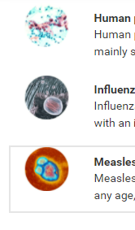
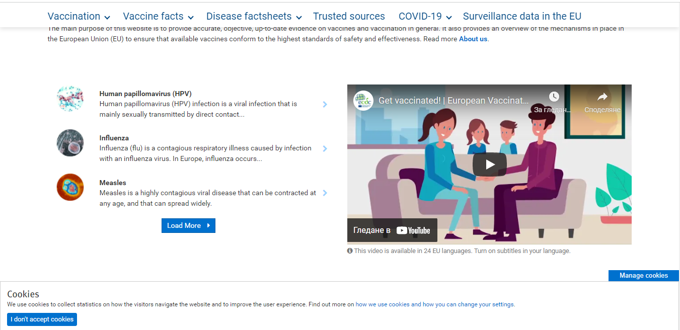

Contrast: very low contrast. (Success Criterion 1.4.3 and 1.4.1)
Not clear image. Missing width and height in the source

Slide 8
Font size: Small font used, a problem for visually disabled people. (Success Criterion 1.4.4)

Slide 9
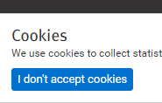
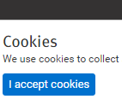
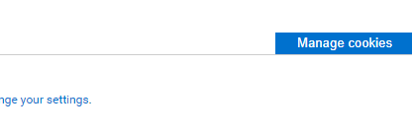

Some users are unable to use a mouse, so use the keyboard instead. onclick handlers should have equivalent onekeyup or onekeydown handler for users with no vision or the one who use alternative keyboards or input devices. (Success Criterion 2.1.1 Keyboard)

Slide 10

Opening new windows: when user don`t expect them.
To open a new window it is used target=_blank.
Displaying a new window without warning can be very confusing to non-sighted and mobile users. ( Success Criterion 3.2.5) .

Slide 11
Pop-up menu: can be confusing for screan reader users.

Slide 12

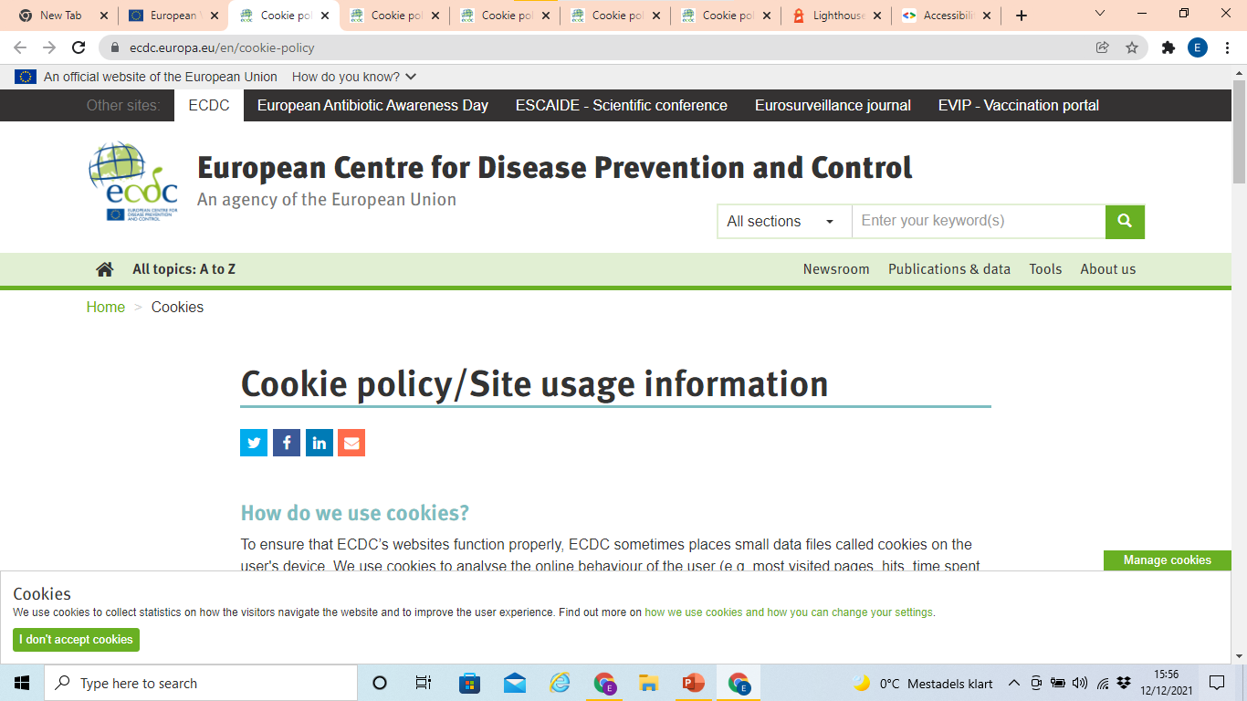
When we click on link ”how we use cookies” we are redirected to another web site that can be confusing for screen readers.

